Slide 1
.NET MAUI Shell

Slide 2
Application Lifecycle What is Shell?
Application Hierarchy
Enables URI-based Navigation
Flyout Navigation
Tab Navigation
Hierarchical Navigation
Best with Dependency Injection

Slide 3
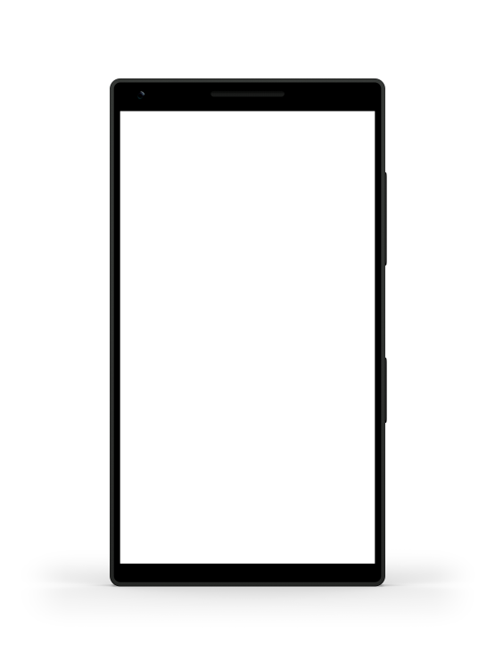
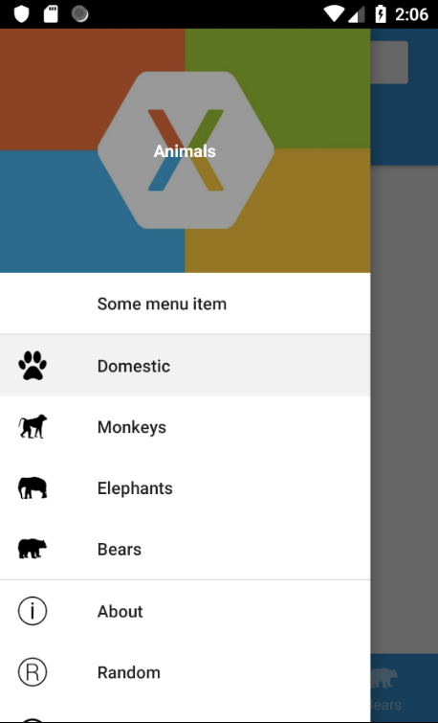
Application Lifecycle Flyout Navigation
Also known as “Master-Detail Page”
Navigation Menu slides in from the left
source: learn.microsoft.com

Slide 4
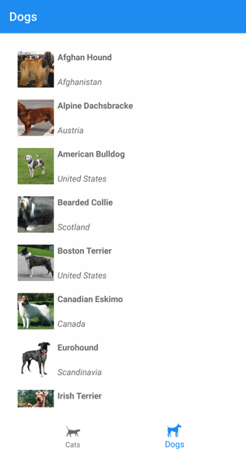
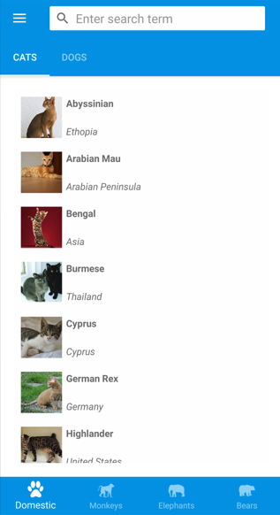
Application Lifecycle Tab Navigation
Bottom Tabs
Default
Main Navigation
Top Tabs
Nested Tab
Bottom Tabs
source: learn.microsoft.com
Top Tabs + Bottom Tabs
source: learn.microsoft.com

Slide 5
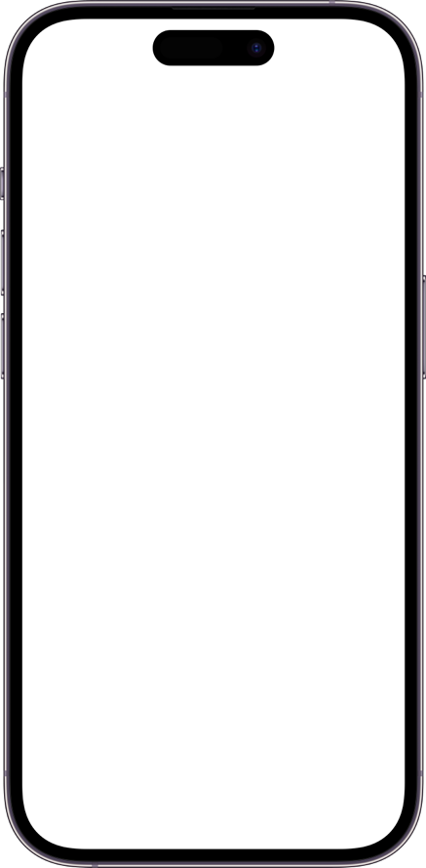
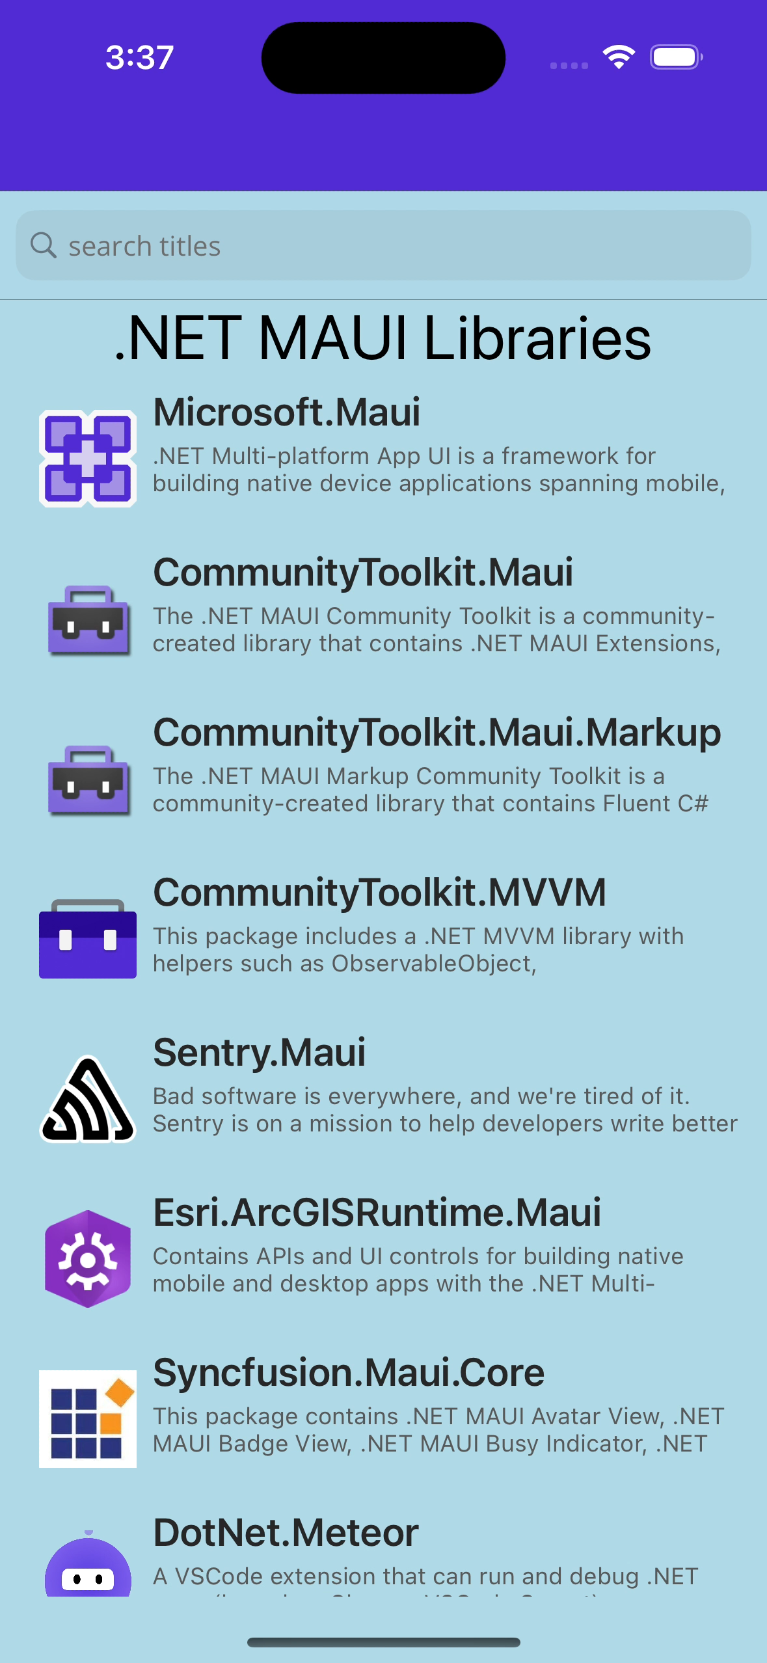
Application Lifecycle Hierarchical Navigation
Navigate Back-and-Forth
Navigation Stacks
NavigationStack
ModalNavigationStack

Slide 6
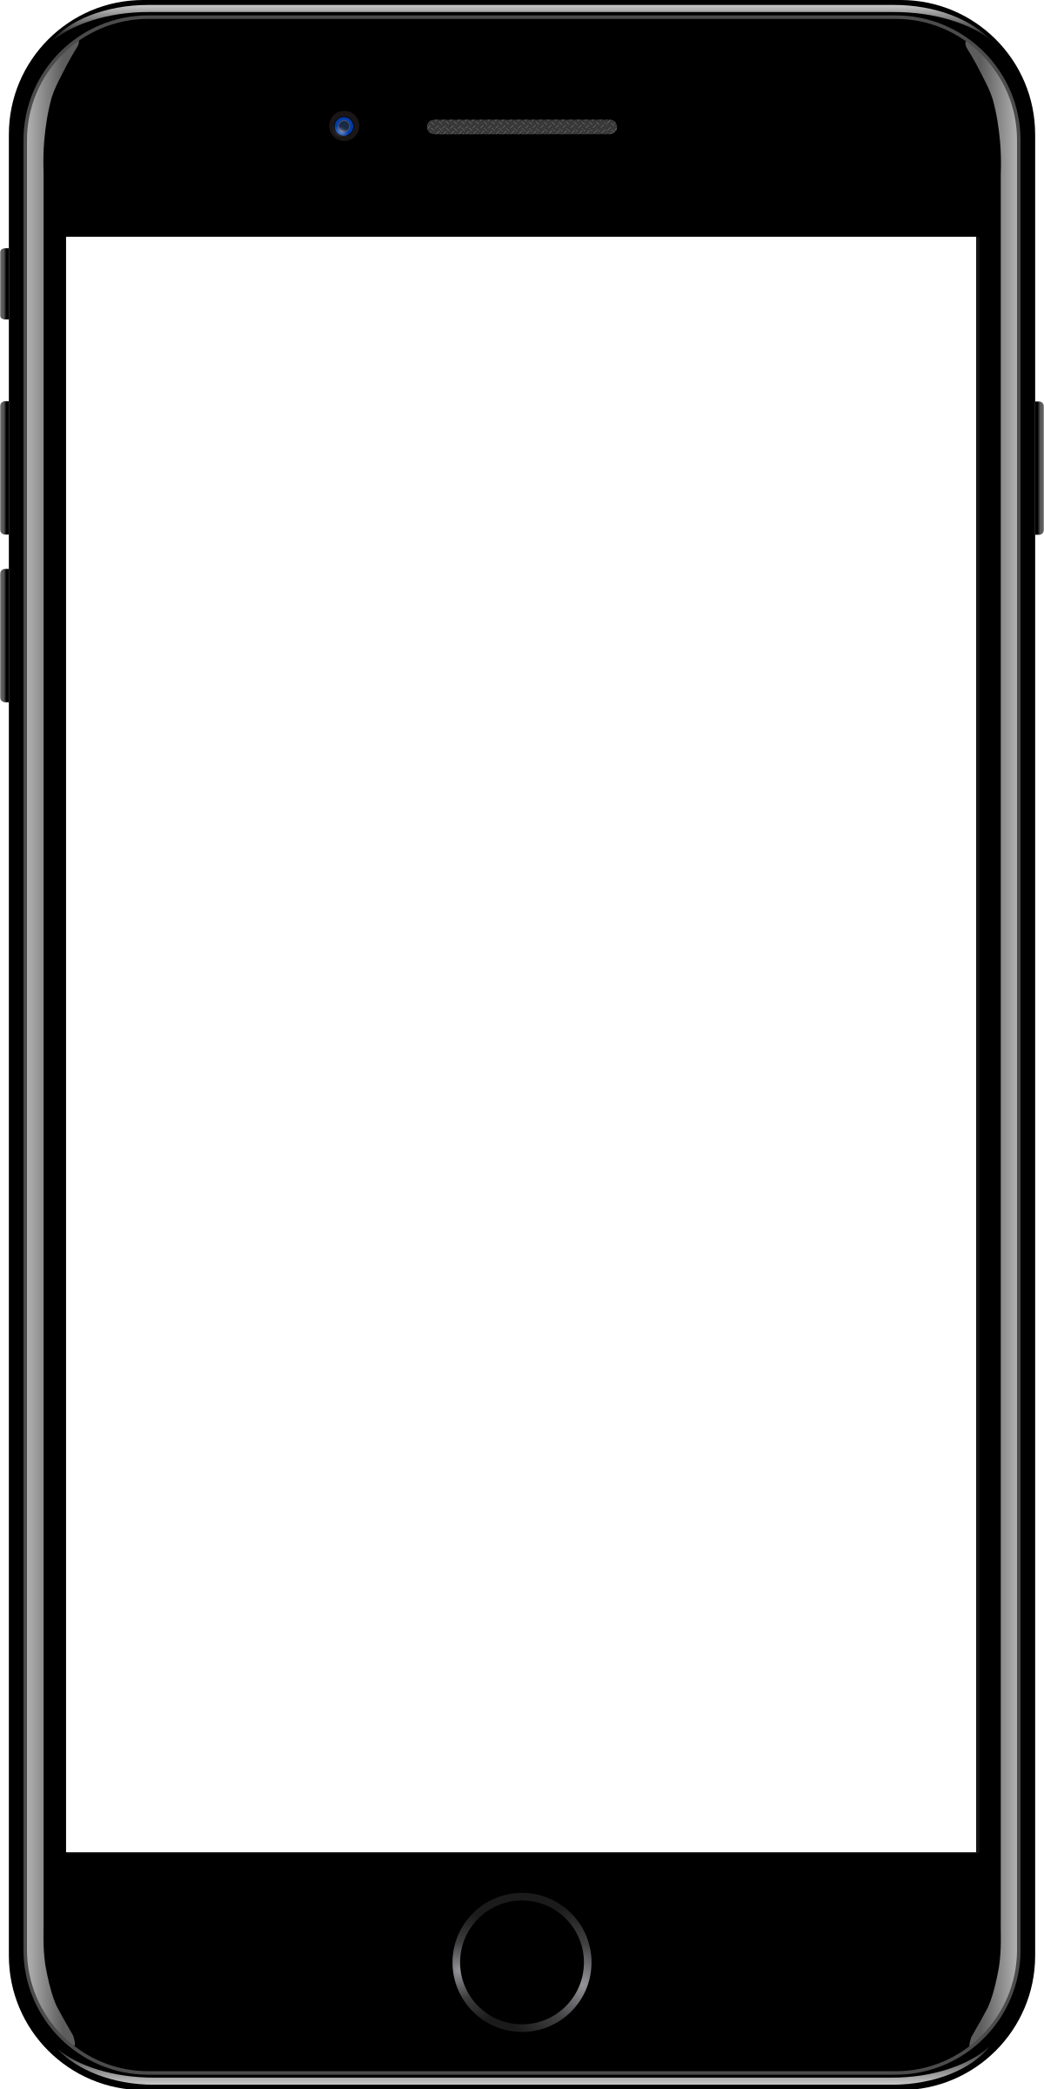
Sample mobile app slide
iPhone 7/8
iPhone 14
Generic phone
(BrandCentral)
App screenshots can be placed behind these transparent .pngs

Slide 7
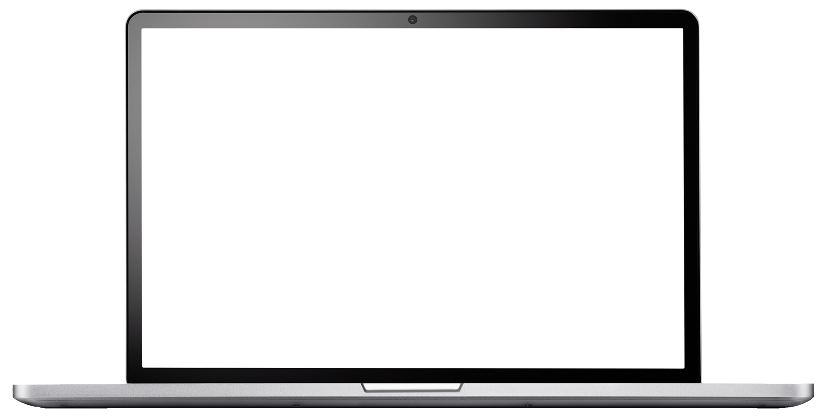
Sample website slide (blank)
Website screenshots can be placed behind this transparent .png

Slide 8
Bullet points layout with subtitle Subtitle is smaller in the same text block
Example of a bulleted slide with a subhead
Set the slide title to “Sentence case”
Set subheads to “Sentence case”
Hyperlink style
www.microsoft.com

